Slide 1
PA Mechanics’ Lien Law and CASPA Update NAWIC – Pittsburgh #161
Amanda Kraft, Esquire
Blumling & Gusky, LLP
436 7th Avenue, Suite 1200
Pittsburgh, PA 15219
412-227-2544 January 29, 2019
akraft@bglaw-llp.com

Slide 2
What is a Mechanic’s Lien?
Statutory lien by a contractor, subcontractor or supplier
A recorded mechanic’s lien serves as security for amounts due the claimant
Mechanic’s Lien
Lien on property as of date of filing
Priority relates back to commencement of work
Lender concerns re recording mortgage
Breach of Contract
Lien on property after trial or arbitration
File Complaint in court or arbitration demand
Discovery
Trial or arbitration
Enter judgment on verdict/award
Priority as of entry of judgment

Slide 3
Who can file a Mechanic’s Lien Claim?
General or Prime Contractor
Subcontractor/Supplier (1st Tier)
Sub-subcontractor/Supplier (2nd Tier)

Slide 4
Pennsylvania mechanics’ lien law - Historical Problems
PA Construction Notices Directory Reduces or Eliminates the following problems:
Inability to identify potential lien claimants
Phantom subcontractor liens
Owners – risk of liens from unpaid subs and suppliers (first and second tier)
Contractors - Risk of liens from second tier subs and suppliers
Mirror other states – Notice of Commencement and Notice of Furnishing – Ohio, Florida

Slide 5
PA Construction Notices Directory
State-wide database for registration of projects and filing notices
Effective December 31, 2016 and controlled by Dept of General Services (DGS)
State-wide internet database for registration of projects and filing notices (as of 12/31/16)
https://apps.pa.gov/scnd or http://www.scnd.pa.gov/

Slide 6
PA Construction Notices Directory
What projects must be registered?
Private projects over $1.5 million
Owners / General Contractors
Notice of Commencement
Notice of Completion - voluntary
Subcontractors / Suppliers
Notice of Furnishing
Notice of Nonpayment - voluntary

Slide 7
PA Construction Notices Directory
Filing Notice of Commencement
Allows an Owner and GC to limit number of potential subcontractor/ suppliers lien claimants
File prior to commencement of labor, work or furnishing of materials on Project
Where Owner files Notice of Commencement
Subcontractors / suppliers required to file Notice of Furnishing
45 days after sub/supplier first performs work or provides materials
Subcontractors / suppliers that fail to timely file Notice of Furnishing forfeit mechanic’s lien rights

Slide 8
PA Construction Notices Directory
Reduction of risk for Owners and Contractors
Progress and Final Lien Waivers
Final payment and Project closeout
General Contractor can file Notice of Commencement for Owner
Owner can authorize GC by contract to file Notice of Commencement
BUT lien law provides that Owner continues to assume responsibility for Contractor’s actions in filing Notices on Owner’s behalf
Best idea: Owner should control process and file Notice of Commencement

Slide 9
PA Construction Notices Directory
Notice of Commencement content requirements
Name, address, contact information and email address of Contractor
Project Name
Project Description
Legal Description
Parcel Tax ID number of each parcel included in subject property
County in which project is located
Building Permit number for the Project
Project address (if available)
Surety - If applicable, name and contact info of surety for any performance or payment bonds applicable to the project, including bond numbers
Unique identifying number assigned to each Notice of Commencement by DGS upon filing

Slide 10
PA Construction Notices Directory
Notice of Furnishing
Provided Owner timely files a Notice of Commencement
Subcontractors and sub-subcontractors and suppliers must timely file Notice of Furnishing
Subcontractors must file within 45 days after first furnishing labor or materials to Project
Or automatic forfeiture of lien rights for failure to timely file Notice of Furnishing
Owner or Contactor (acting as agent) notified of each subcontractor/supplier that files Notice
Preserves subcontractor and supplier lien rights

Slide 11
Additional Mechanics’ Lien Requirements
Posting Notice of Commencement
Posting Requirements
Notice must be conspicuously posted on site
Locations for posting –
Owner and GC trailers
Project entrance
Timing of Posting
Before physical work commences
Remains posted until completion
Reposting – within 48 hours after being aware of or being notified verbally or in writing

Slide 12
Additional Mechanics’ Lien Requirements
Statutory notice required in GC Contract
“A Subcontractor that fails to file a Notice of Furnishing on the Department of General Services’ publicly accessible Internet Website as required by the act of August 24, 1963 (P.L. 1175, No. 497), known as the Mechanics’ Lien Law of 1963, Subcontractor may forfeit the right to file a mechanics lien. It is unlawful for a searchable project owner, searchable project owner’s agent, contractor or subcontractor to request, suggest, encourage or require that a subcontractor not file the required notice as required by the Mechanics’ Lien Law of 1963.”
Contractor shall include this language in all subcontracts and purchase orders issued for the supply of labor or materials used in connection with the Project

Slide 13
Additional Mechanics’ Lien Requirements
Contract requirements for Notice of Commencement
Notice of Commencement identified as Contract Document and provided to subcontractors
Owner and Contractor shall make reasonable efforts to ensure that the Notice of Commencement is made part of the Contract Documents provided to all subcontractors awarded work on the searchable project.
Owner should attach Notice of Commencement as Exhibit to Contract
Owner should identify Notice of Commencement among List of Contract Documents
Require Contractor to include Notice of Commencement as Exhibit to all subcontracts and purchase orders

Slide 15
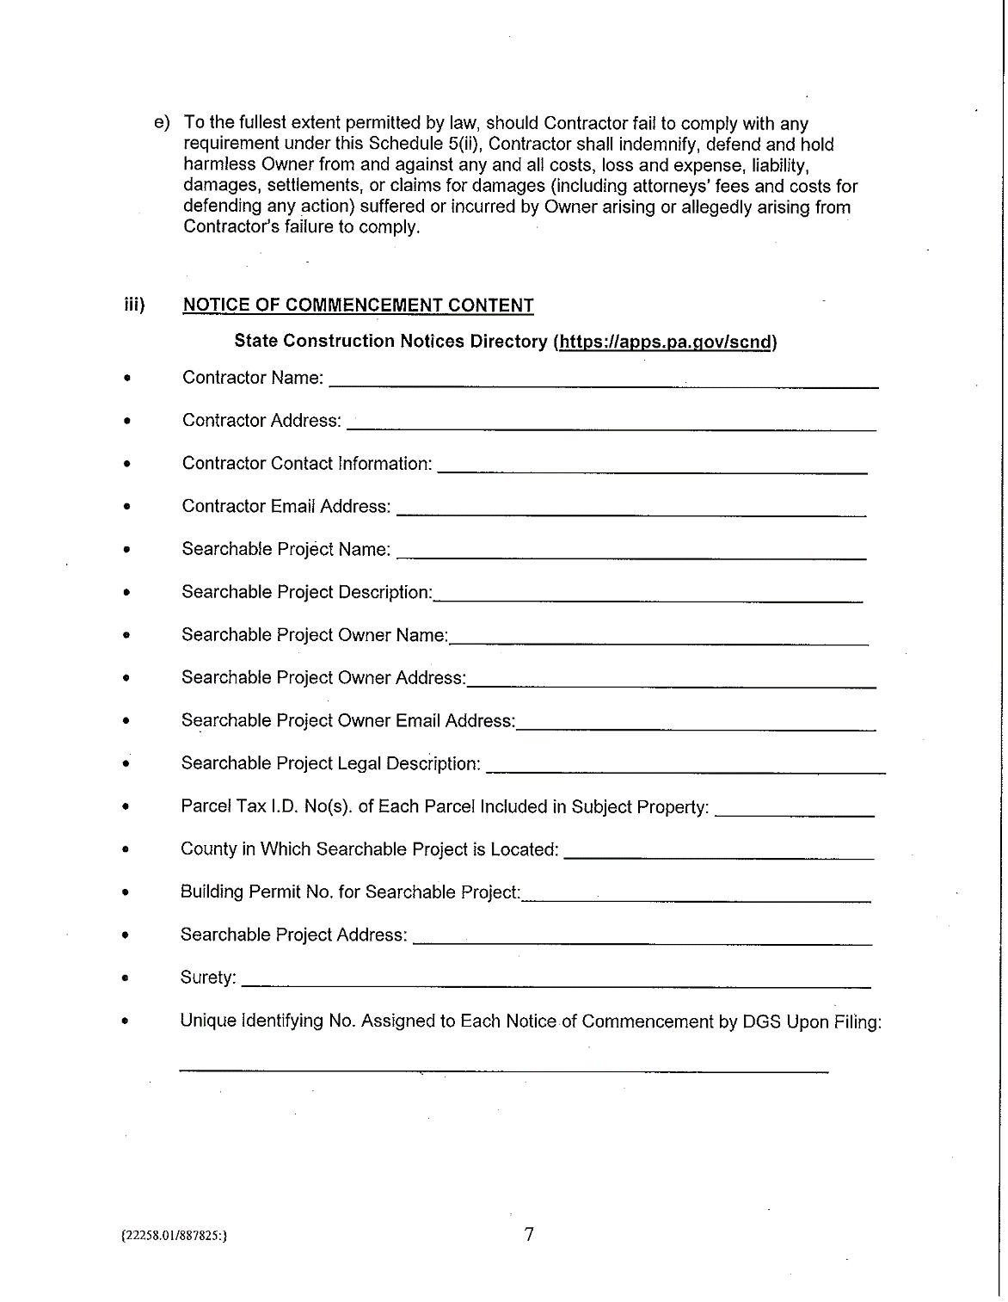

Slide 16
Deadlines for Mechanics’ Liens
Pennsylvania
Owner to File Notice of Commencement before physical commencement of Work on site
If Notice of Commencement filed by Owner, all Subcontractors and Suppliers must serve Notice of Furnishing within 45 days after first work to preserve lien rights
Lien must be filed within 6 months from last Work (contractors and subcontractors)
Formal notice required by Subcontractors at least 30 days in advance of filing
Suit to enforce lien must be filed within 2 years of filing
Ohio
Owner to File Notice of Commencement before physical commencement of Work on site
If Notice of Commencement filed, all Subcontractors and Suppliers must serve Notice of Furnishing Within 21 days of first work to preserve lien rights
Affidavit of Lien must be filed within 75 days of last work
Affidavit must be served on Owner within 30 days of filing
Owner can serve Notice to Commence Suit within 60 days
West Virginia
Notice must be served on Owner and recorded in Clerk’s Office within 100 days of last work
Suit to enforce the lien must be filed within 6 months of notice

Slide 17
What is CASPA?
Contractor and Subcontractor Payment Act
In effect since 1994
Purpose: ensure timely payment by Owner to Contractor and GC to subcontractors
Revisions – Effective October 10, 2018
Not applicable to :
residential projects of less than 6 units (under simultaneous construction) or
contracts for purchase of materials by people performing work on their own property

Slide 18
PA CASPA - Update
Prohibition of Waiver
Blanket waiver of CASPA is no longer valid!
Unless specifically permitted under the Act, CASPA now specifically prohibits the waiver of any provision of CASPA
Exceptions include – time for payment, interest
These can (and should) be specified in the Contract

Slide 19
PA CASPA - Update
Pay-if-paid Clauses
In order to have a valid pay-if-paid clause under a downstream subcontract subject to CASPA, the due dates of the payments (progress and final) from the Owner to the General Contractor must be disclosed to a Subcontractor prior to entering into the subcontract

Slide 20
PA CASPA – Update –
Owner’s Withholding of Payment for Deficiency Item
Owner must provide a “written explanation of its good faith reason” for withholding payment from Contractor for a “deficiency item” within 14 calendar days of the date when the Contractor’s invoice is received
Any failure to comply with this written explanation within the 14 day requirement “shall constitute a waiver of the basis to withhold payment and necessitate payment of the Contractor in full for the invoice”
Owner must pay all amounts due for satisfactory (non-deficiency) work

Slide 21
PA CASPA – Update –
Contractor’s Withholding of Payment from Subcontractor/Supplier for Deficiency Item
Contractor must provide written notice and explanation of a deficiency item and intention to withhold payment must be given within 14 calendar days of receipt of Subcontractor’s Application for Payment.
Waiver language applicable to an Owner’s withholding of payment has not been extended to Contractors.
Contractor must pay all amounts due for satisfactory (non-deficiency) work

Slide 22
PA CASPA – Update – O and GC
Errors in Documentation
If an invoice is filled out incorrectly or incompletely, the person who receives the incorrect invoice shall give written notice of the error within 10 working days of receipt of the invoice
Owner or Contractor shall still pay the correct amount of the invoice on the due date in accordance with Act

Slide 23
PA CASPA – Update
Withholding of Retainage
Owner (and Contractor) is prohibited from withholding retention for more than 30 days unless written notice has been provided of deficiency items to Contractor (or a sub) and the balance of the retention for work which is not deficient has been paid
Security in Lieu of Retention
Contractors (and subcontractors) can facilitate release of retention prior to final completion by posting maintenance bond for 120% of amount retained
No specific time period for bond

Slide 24
PA CASPA - Update
Contractor’s Right to Stop Work
Statutory, non-waivable right to suspend performance of a construction contract under the following 3 conditions:
(i) Payment to the contractor has not been made when due under the contract;
(ii) The contractor must send owner written notice that payment has not been made after at least thirty (30) days have passed since the end of the billing period for which the payment was not received; and
(iii) The contractor must send the owner a second written notice after at least thirty (30) days have passed since the first written notice and at least ten (10) days prior to stopping the work.
Subcontractors have a separate but similar right to suspend their performance

